Slide 1

Final Presentation
Bank Marketing Campaign
Aditi Dadariya - July 30th 2023

Slide 2
Agenda
Introduction
Literature Review
Methodology and Results
Discussion and Analysis
Conclusion and Future Work
References

Slide 3
Introduction
Background and Motivation:
In the realm of decision-making, direct marketing and telemarketing play a significant role as customers rely on reviews to assess long-term benefits. While technology influences response behaviour, customers seek advantageous options for loans and term deposits. Simultaneously, banks aim to enhance customer interactions for profitable outcomes. This study evaluates multiple machine learning models to predict the term deposit product for ABC Bank.
Research Problem:
ABC Bank aims to introduce its term deposit product to customers. To ensure a successful launch, they seek to develop a model that can predict whether a customer is likely to purchase the product based on their past interactions with the bank or other financial institutions.
Aims and objectives:
The dataset pertains to direct marketing campaigns conducted by a Portuguese banking institution. The bank aims to leverage a machine learning model to identify and prioritize customers with a higher likelihood of purchasing the product. This will enable the marketing channels, such as tele marketing, SMS/email marketing, to concentrate their efforts on these targeted customers.

Slide 4
Methodology and Results
Dataset Description
Data Pre-processing
Data Visualization
EDA Summary
Recommendation
Data Modelling and Results
Model Deployment

Slide 5
Dataset Description
In total, the dataset consists of 41,188 records and 21 variables. These variables include 'age', 'job', 'marital', 'education', 'default', 'housing', 'loan', 'contact', 'month', 'day_of_week', 'duration', 'campaign', 'pdays', 'previous', 'poutcome', 'emp.var.rate', 'cons.price.idx', 'cons.conf.idx', 'euribor3m', 'nr.employed', and 'y'. The target variable is denoted by 'y', while the remaining variables are considered as features.
The data types of the variables vary, 'age', 'duration', 'campaign', 'pdays', and 'previous' are of the int64 data type, while 'emp.var.rate', 'cons.price.idx', 'cons.conf.idx', 'euribor3m', and 'nr.employed' are of the float64 data type. The variables 'job', 'marital', 'education', 'default', 'housing', 'loan', 'contact', 'month', 'day_of_week', 'poutcome', and 'y' are of the object data type.

Slide 6
Data Pre-processing
Missing Values: In some categorical attributes, there are instances of missing values denoted by the label "unknown”. The decision was made not to drop these labels due to their substantial presence in the dataset. Removing these values could potentially impact the integrity of the training data. Hence, these labels can be approached in different ways by first replacing them into null values and later an imputation techniques (i.e. SimpleImpute) has been applied to handle these missing values.
Inconsistent datatypes: Once the "unknown" values were transformed into NaN values, the categorical variables ('job', 'marital', 'education', 'default', 'housing', 'loan') were examined for potential mixed datatypes. However, it was confirmed that these variables do not exhibit multiple datatypes, as they are consistently of the same datatype throughout the dataset.
Encoding the categorical variables: Prior to converting the categorical variables into numeric values, an assessment was conducted to determine whether each variable falls under binary categorical or multi-categorical classification. Binary categorical variables were encoded using Label Encoder, while multi-categorical variables were encoded using One-Hot Encoder.
Imbalance Dataset: The dataset is imbalance as the target variables has 36,548 values for the category 'no' and 4,640 values for the category 'yes’. To address this issue, the SMOTE (Synthetic Minority Over-sampling Technique) method was employed. Sample of dataset is displayed in Fig 1 below.
Fig 1: Few records of Dataset

Slide 7
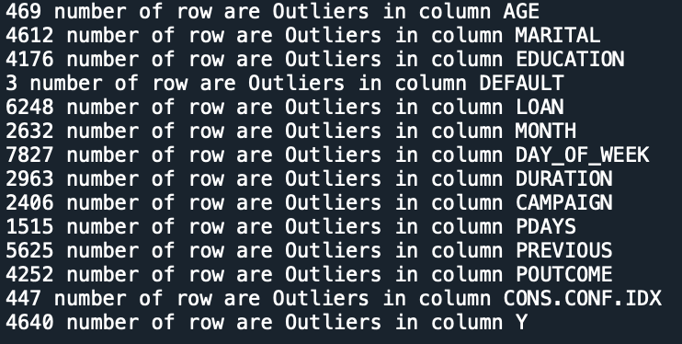
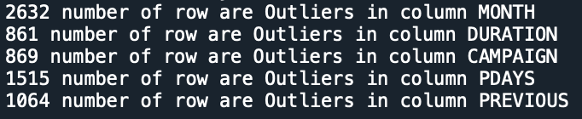
Data Pre-processing Cont.
Outliers Detection: Outliers were identified using two methods: the Interquartile Range (IQR) method as displayed in Figure 2 and Z-score method as displayed in Figure 3 below. In order to minimize excessive changes to the dataset, a quantile imputation technique was employed to replace the outliers.
Fig 2: Outliers detected by Interquantile Range method
Fig 3: Outliers Detected by ZScore

Slide 8
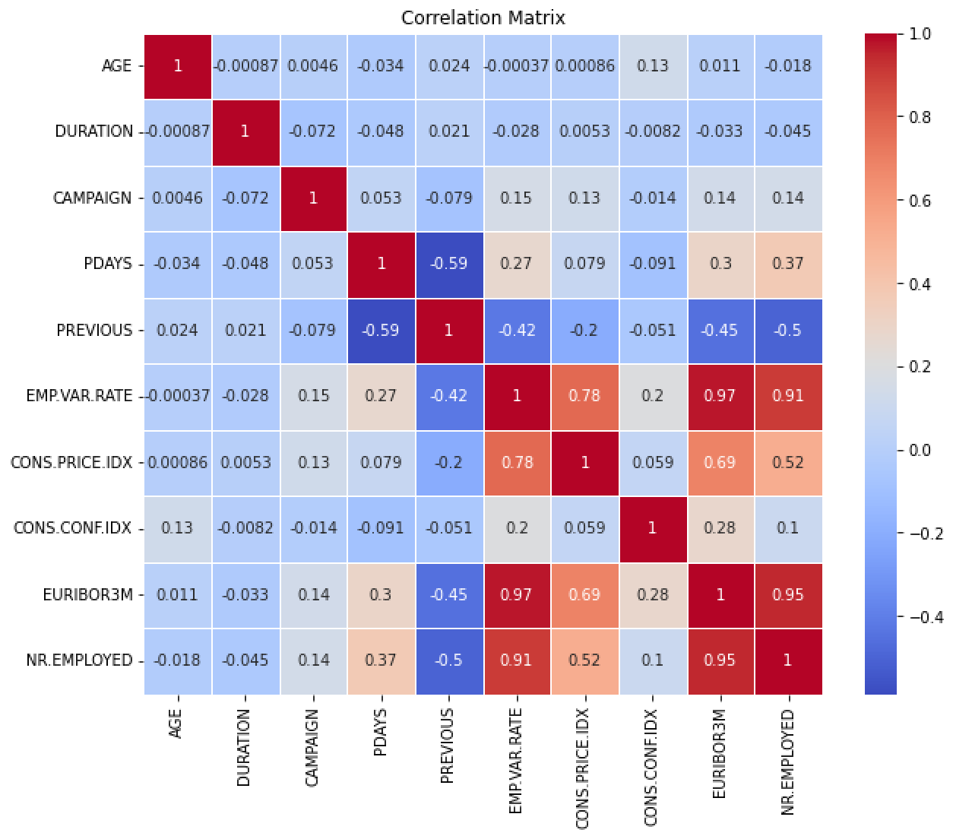
Data Visualization
Correlation between data variables:
Fig 4: Heat map
As depicted in Fig 4, there seems to be a
Correlation between EMP.VAR.RATE and CONS.PRICE.IDX: 0.7753
Correlation between EMP.VAR.RATE and EURIBOR3M: 0.9722
Correlation between EMP.VAR.RATE and NR.EMPLOYED: 0.9070
Correlation between CONS.PRICE.IDX and EURIBOR3M: 0.6882
Correlation between CONS.PRICE.IDX and NR.EMPLOYED: 0.5220
Correlation between EURIBOR3M and NR.EMPLOYED: 0.945

Slide 9
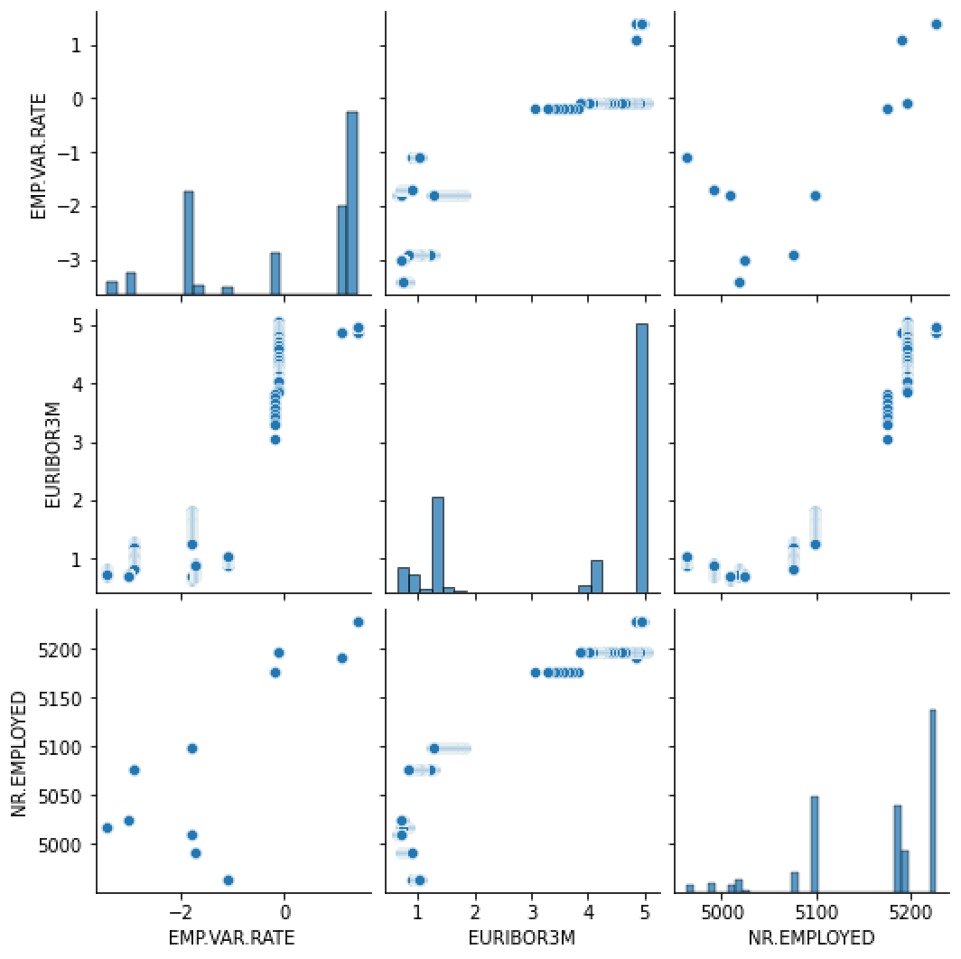
Data Visualization - cont
Fig 5: Pair Plot
These findings suggest a potential relationship among EMP.VAR.RATE, EURIBOR3M and NR.EMPLOYED variables. To further illustrate this relationship, a Pair plot is showcased in Fig 4 above.

Slide 10
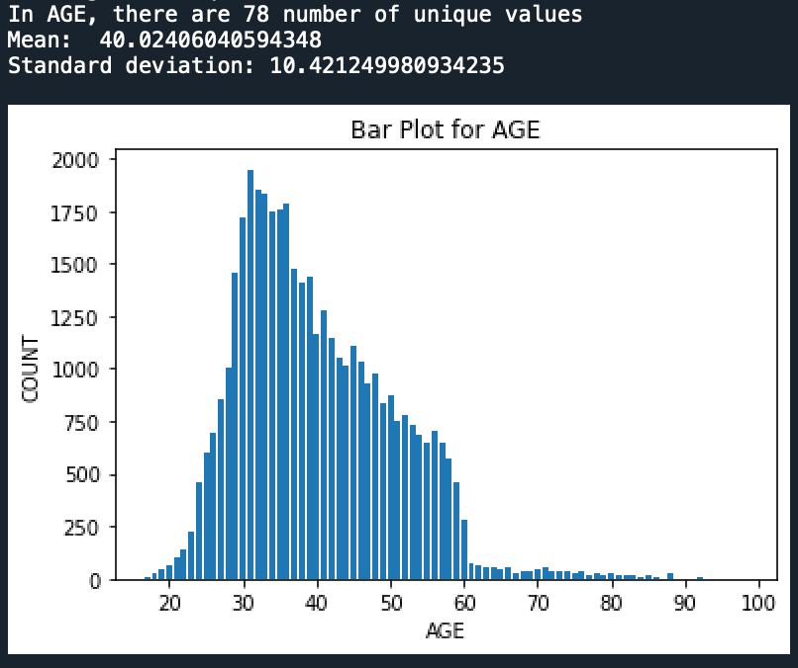
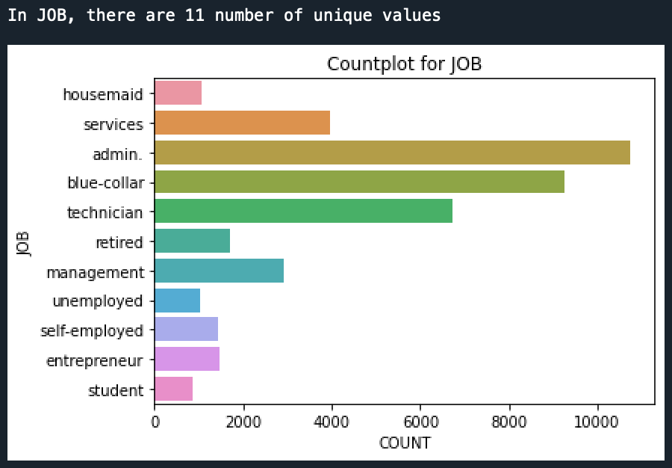
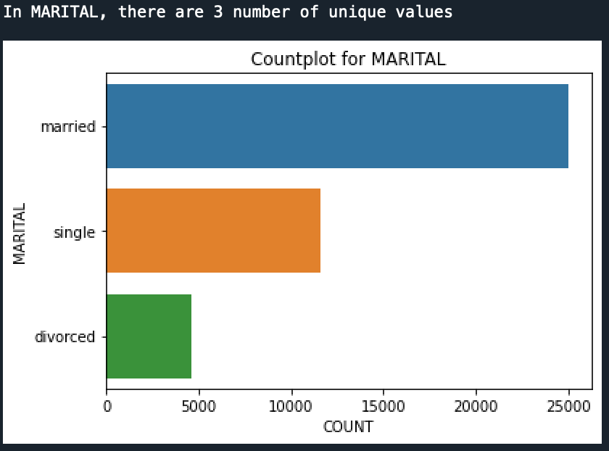
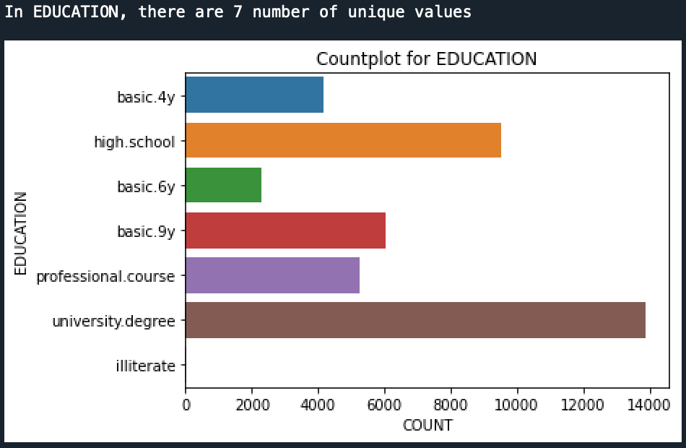
Data Visualization - cont
Understanding each variable individually: The unique values of categorical variables were explored and visualized using bar plots. The numerical variables were analyzed by calculating their mean and standard deviation, providing insights into their distribution. Please refer to Figures 3 to 23 for the detailed visualizations
Fig 6: Age variable Fig 7: Job variable
Fig 6 shows that the age range of customers who are likely to be eligible for a term deposit is between 20 and 60 years. Among the various job categories, administrative jobs have the highest representation, as depicted in Fig 7.
Fig 8: Marital Variable Fig 9: Education variable
Fig 8 indicates that the number of married customers surpasses that of single and divorced customers, suggesting their eligibility for term deposit offers. Fig 9 showcases the presence of university degree holders who are potentially targeted for term deposit contact.

Slide 11
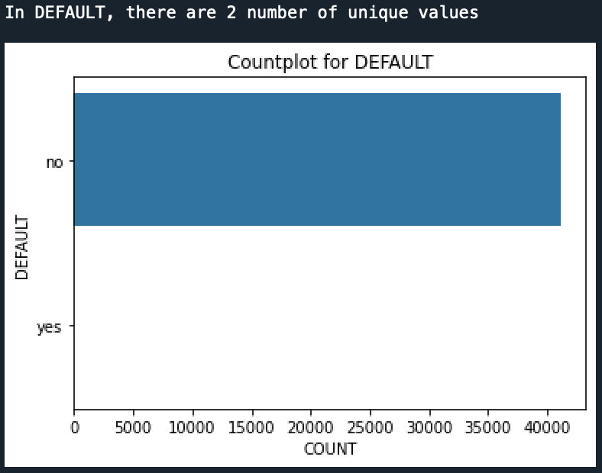
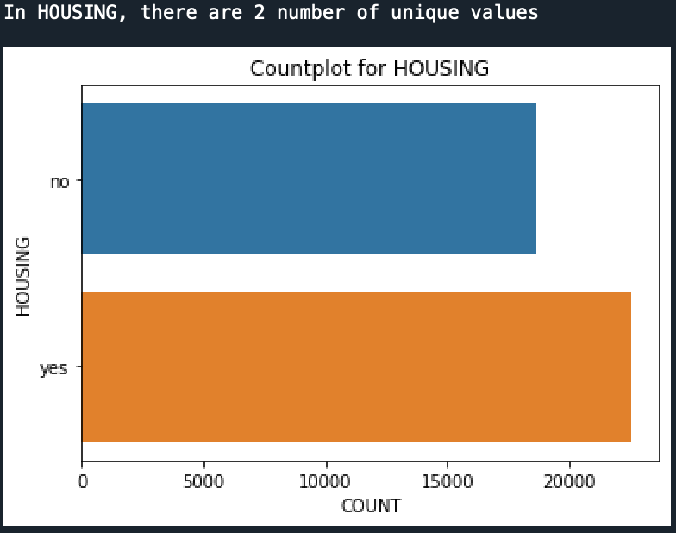
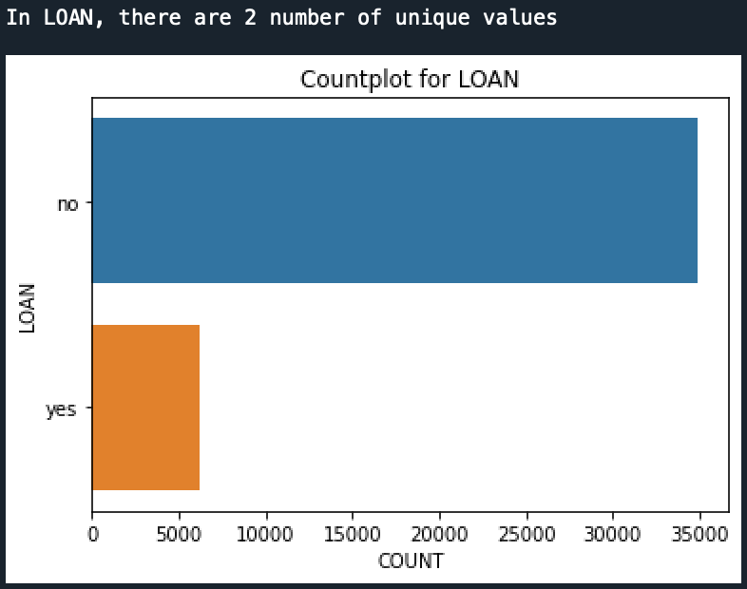
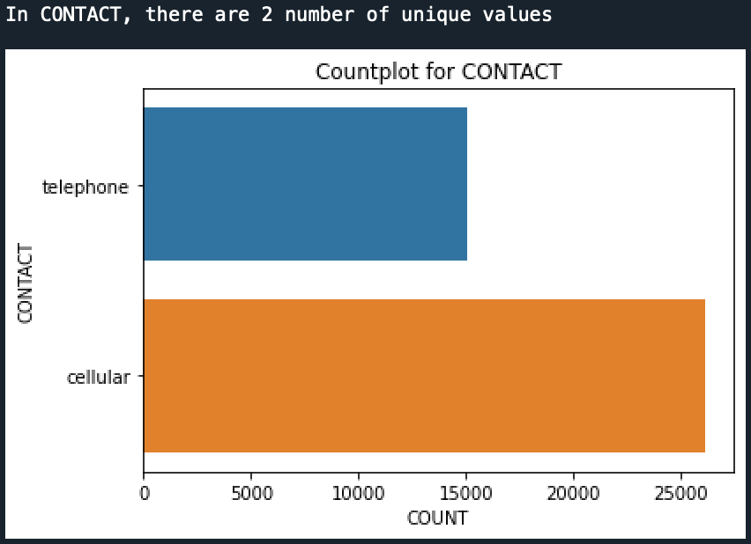
Data Visualization - cont
Fig 10: Default variable Fig 11: Housing variable
Fig 10 reveals that the majority of customers do not have any credit default. Fig 11 illustrates that the number of customers with housing loans is greater than the number of customers without housing loans.
Fig 12: Loan variable Fig 13: Contact variable
As shown in Fig 12, the count of customers with personal loans is significantly lower than the count of customers without personal loans. As depicted in Fig 13, the count of customers with cellular phones is higher compared to customers with telephone connections. December

Slide 12
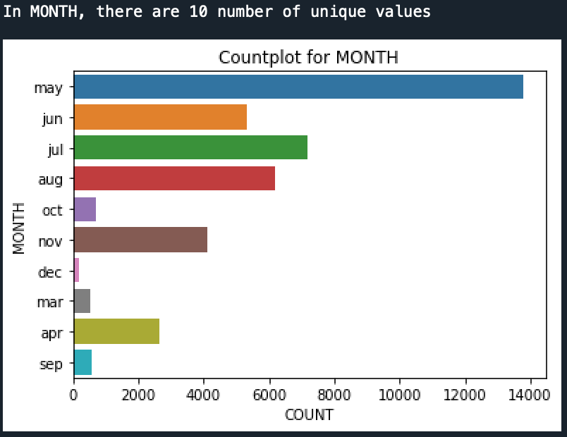
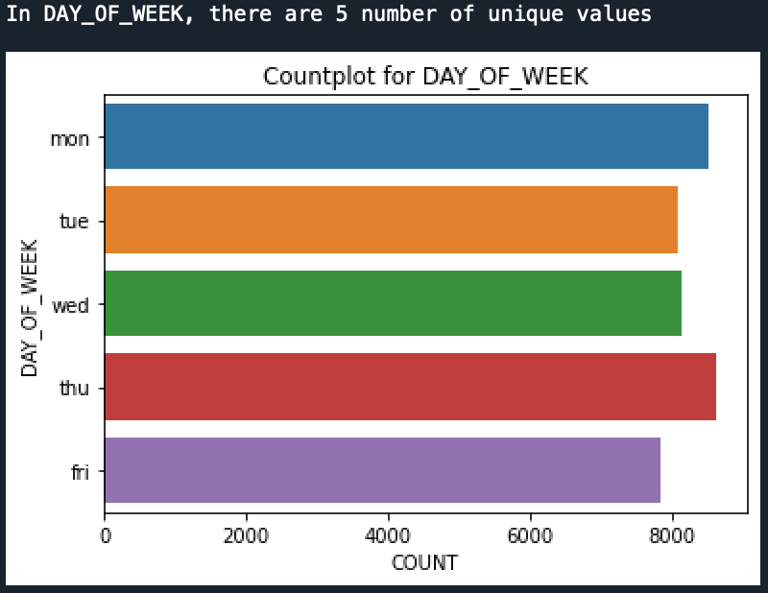
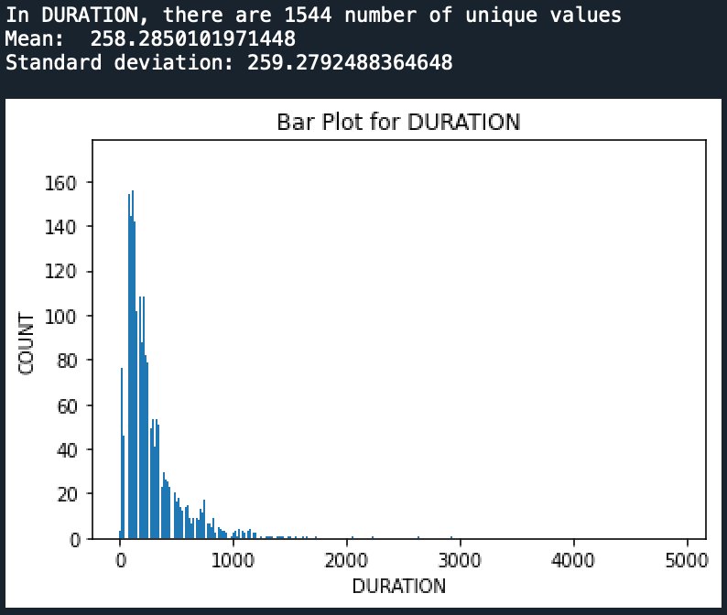
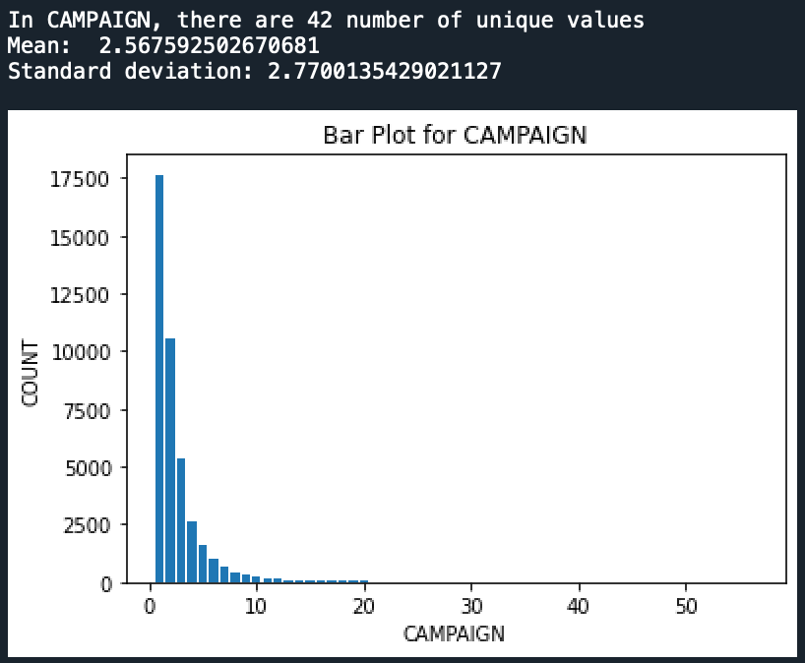
Data Visualization - cont
Fig 14: Month Variable Fig 15: Day_of_Week
As shown in Fig 14, the majority of customers were contacted during the month of May in the past. As depicted in Fig 15, the number of customers contacted during the weekdays shows a slight increase on Mondays and Thursdays, although the overall impact is not substantial.
Fig 16: Duration variable Fig 17: Campaign variable
As shown in Fig 16, the duration of calls ranged from 0 to 1000 seconds. On an average, the calls lasted for approximately 258.28 seconds with the customers. As shown in Fig 17, the number of contacts made during the campaign ranged from 1 to 10, with a significant proportion of customers being contacted only once.

Slide 13
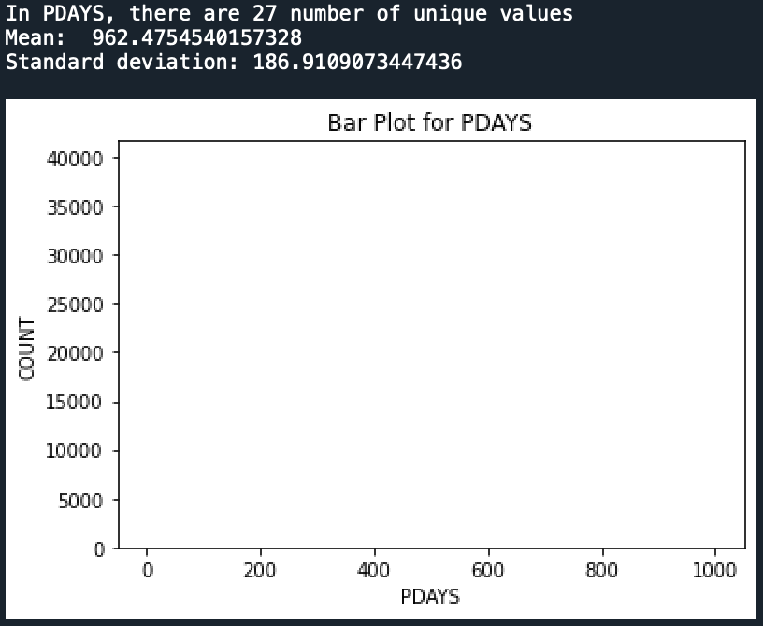
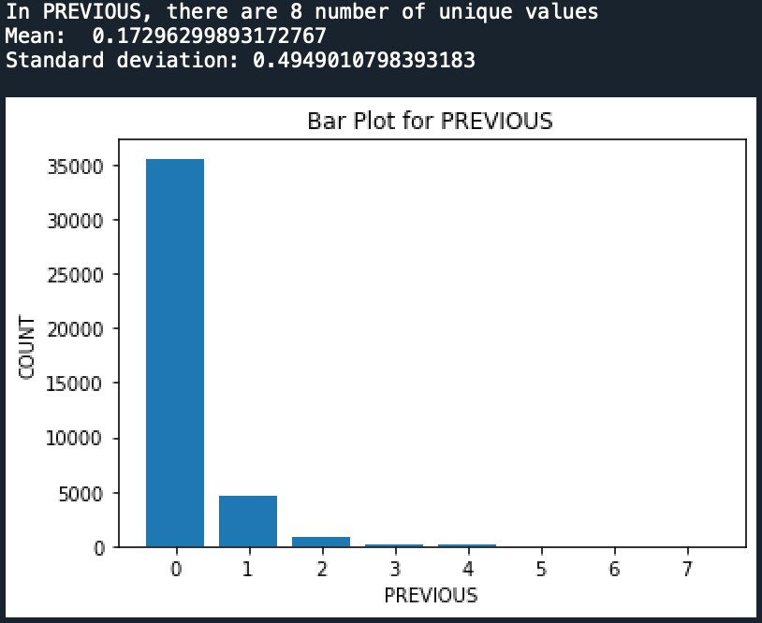
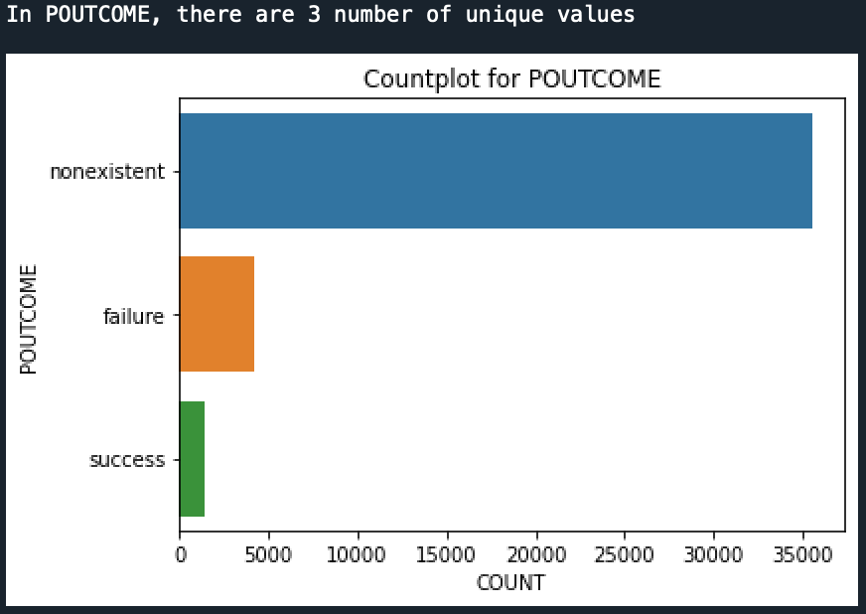
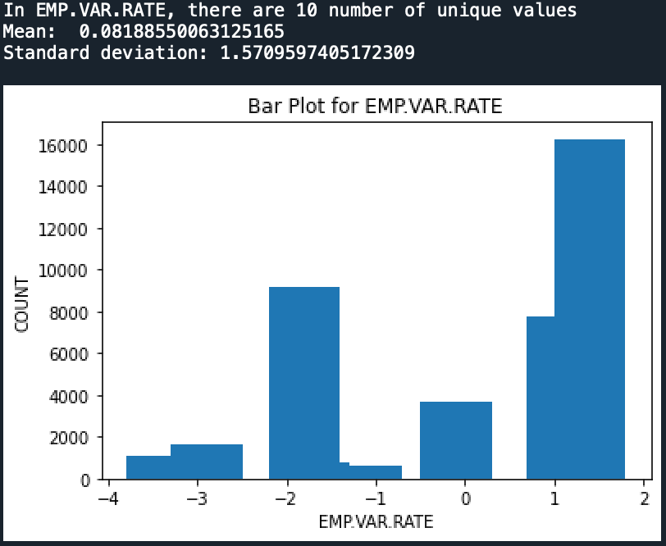
Data Visualization - cont
Fig 18: PDays variable Fig 19: Previous variable
As depicted in Fig 18, the average number of times customers were contacted before the campaign was relatively low. As shown in Fig 19, the number of calls made to customers prior to the campaign is relatively low. Only a small number of customers have been contacted once or twice before the campaign
Fig 20: POutcome variable Fig 21: EMP.VAR.RATE variable
Based on Fig 20, the majority of the previous marketing campaign outcomes are non-existent, with a smaller number of successes and failures. Based on Fig 21, the employment variation rate is highest between 1 and 2, with an average of 0.0818.

Slide 14
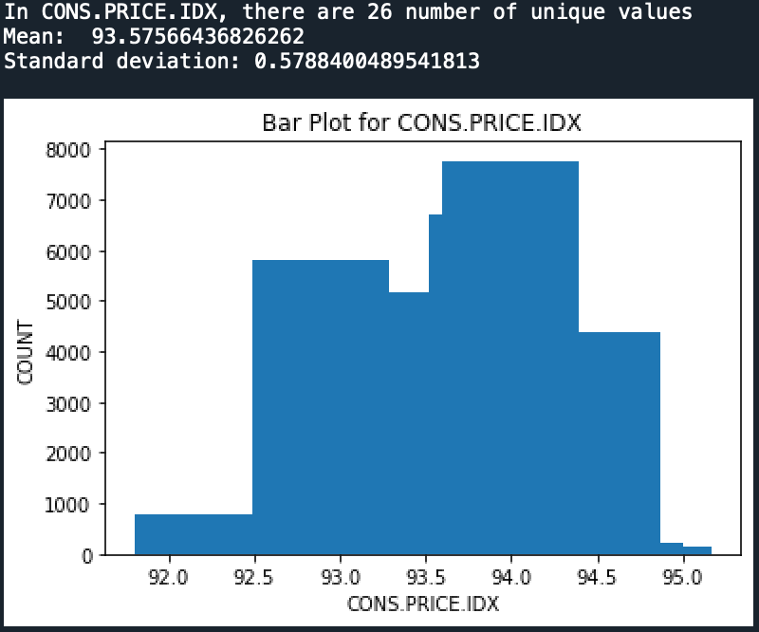
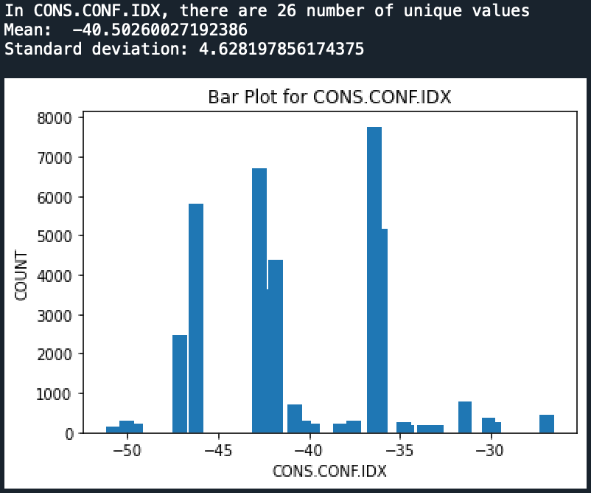
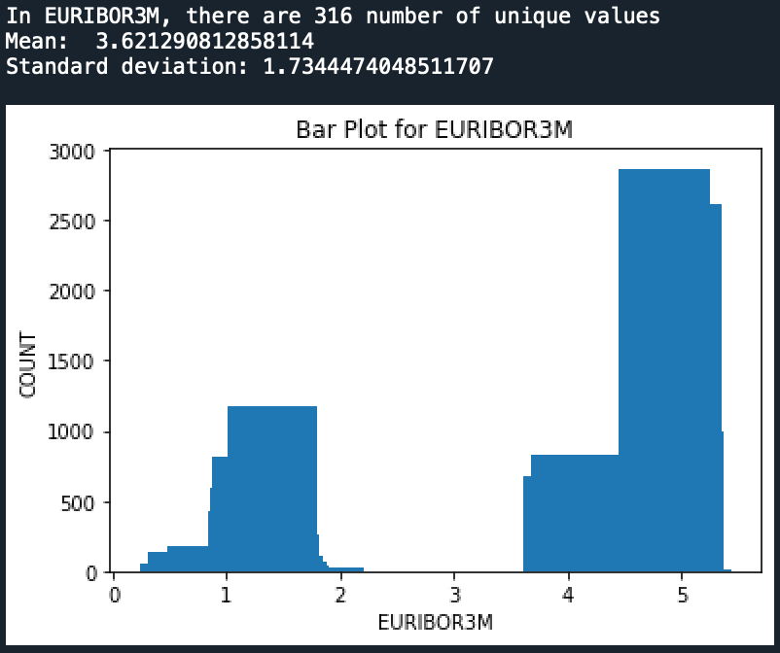
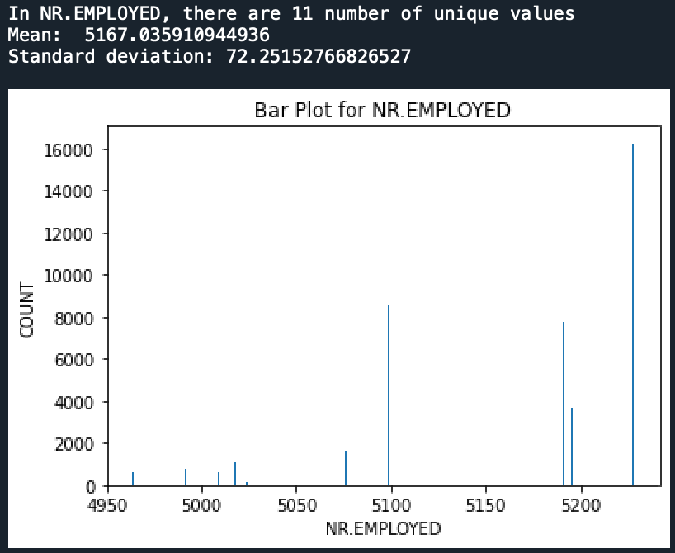
Data Visualization - cont
Fig 22: CONS.PRICE.IDX variable Fig 23: CONS.CONF.IDX variable
According to Fig 22, the average customer price index is 93.57, with a range between 92.5 and 94.5. Fig 23 indicates that the customer confidence index ranges from -35 to -38, with an average value of -40.50
Fig 24: EURIBOR3M variable Fig 25: NR.Employed variable
Fig 24 shows that the maximum Euribor 3 month rate falls within the range of 4 to 5. Fig 25 illustrates that the average number of employees is 5167, with a maximum exceeding 5200.

Slide 15
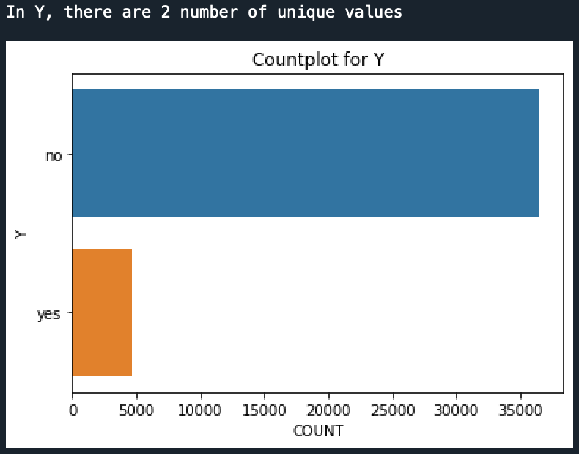
Data Visualization - cont
Fig 26: Y target variable
According to Fig 26, it reveals that a small number of customers already have a term deposit.

Slide 16
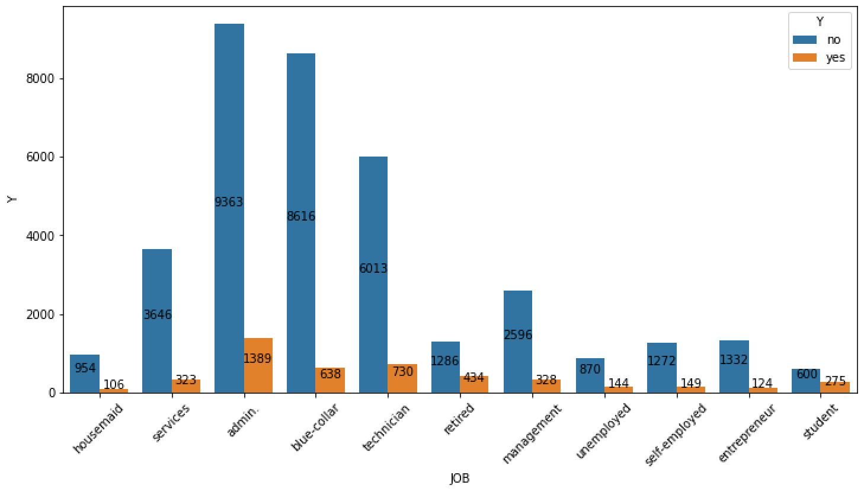
Data Visualization - cont
Relation of categorical variable with target variable: Below are the plots that illustrate the relationship between categorical variable and the target
Fig 27: Job versus Y
Fig 27 demonstrates that the highest number of customers with a term deposit are employed in administrative roles. 1389 number of administrator customers has already taking the term deposit.

Slide 17
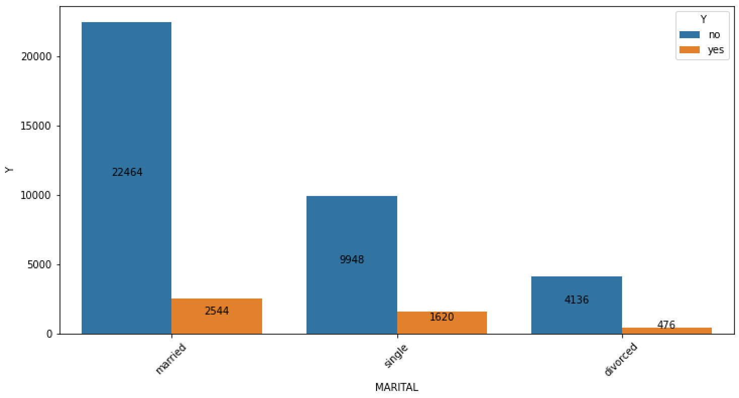
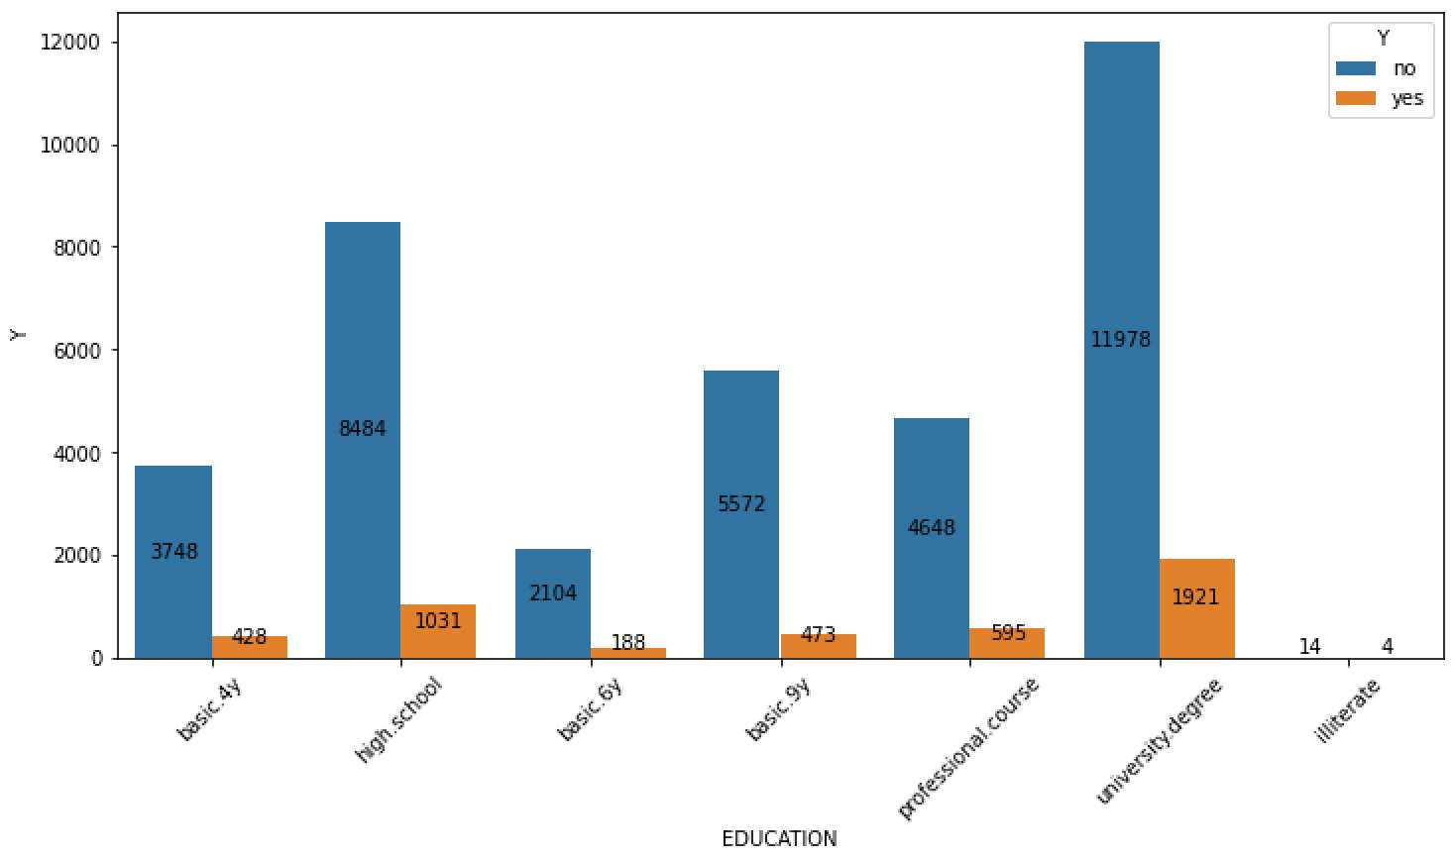
Data Visualization - cont
Fig 28: Marital versus Y
Fig 28 illustrates that the highest number (i.e. 2544) of customers with a term deposit are married individuals.
Fig 29: Education versus Y
As shown in Fig 29, the majority of customers (i.e. 1921) with a term deposit are those who hold a university degree.

Slide 18
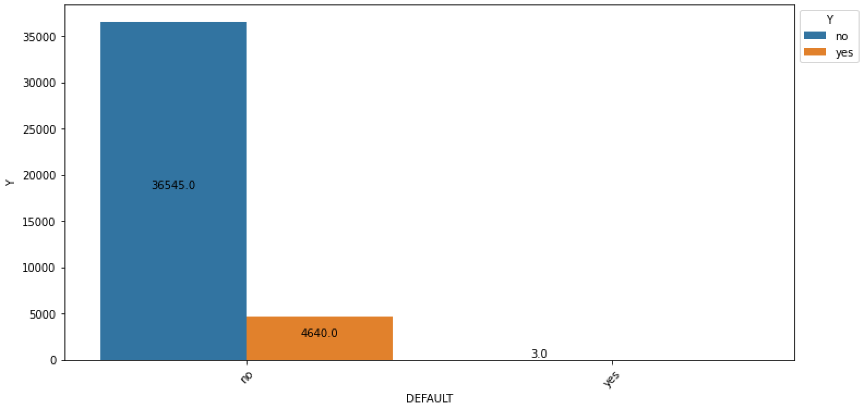
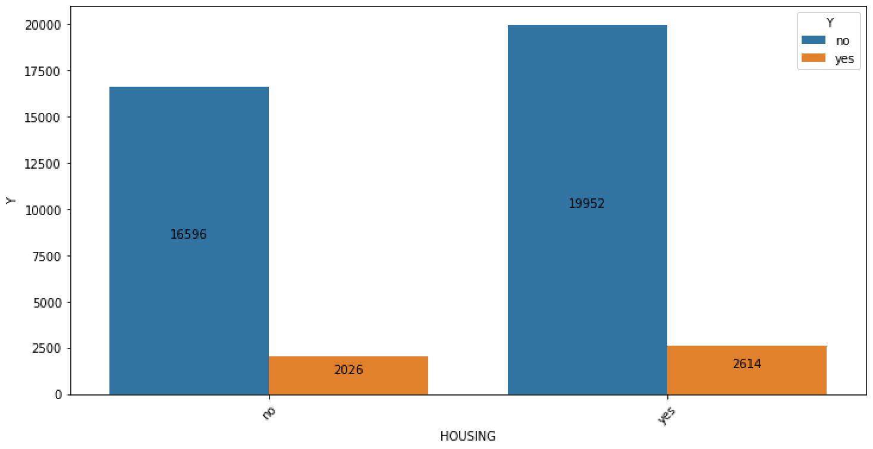
Data Visualization - cont
Fig 30: Default versus Y
According to Fig 30, there is a total of 4640 customers who have had a term deposit in the past.
Fig 31: Housing versus Y
Based on the information shown in Fig 31, there is a relatively similar proportion between housing loan holders who have a term deposit and those who do not have a term deposit.

Slide 19
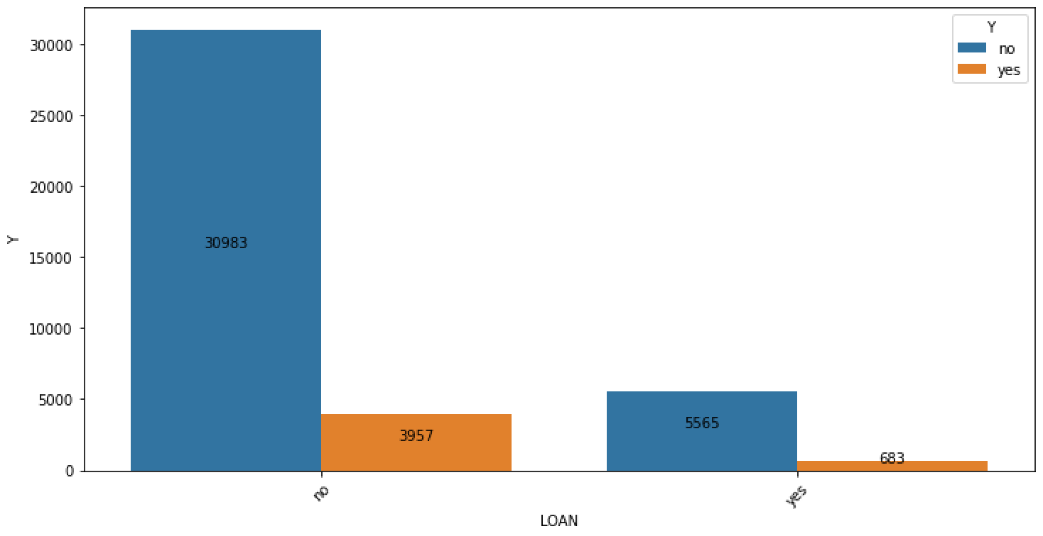
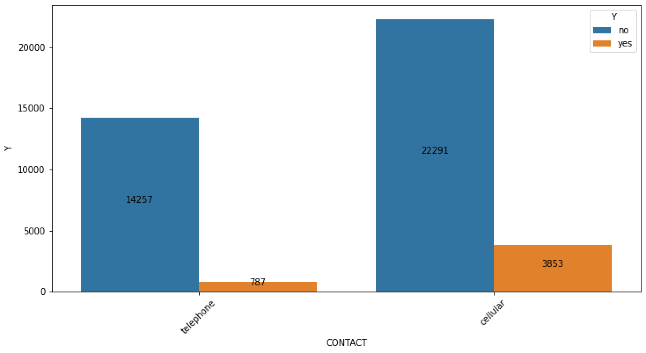
Data Visualization - cont
Fig 32: Loan versus Y
Based on the data presented in Fig 32, it can be observed that the number of term deposits for customers without a personal loan is significantly higher compared to those with a personal loan. deposit in the past.
Fig 33: Contact versus Y
Based on the information depicted in Fig 33, it can be observed that the majority of customers who have opted for a term deposit have a cellular phone.

Slide 20
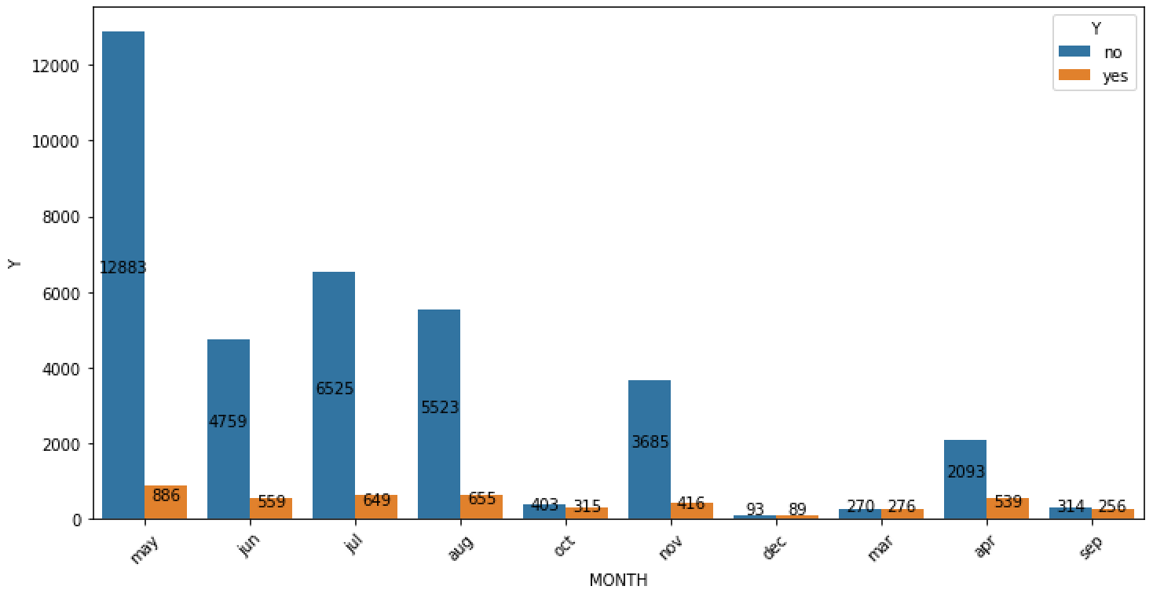
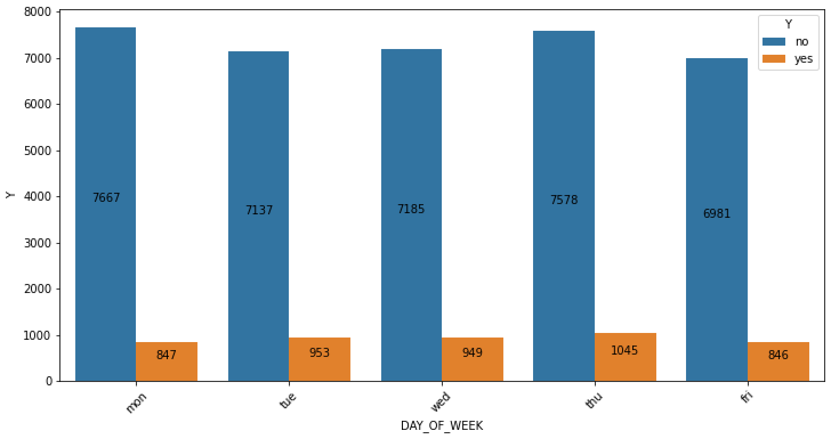
Data Visualization - cont
Fig 34: Month versus Y
Based on the data visualized in Fig 34, it is evident that the majority of customers were contacted during the month of May. Furthermore, this period also witnessed the highest number of conversions to a term deposit.
Fig 35: Day_of Week versus Y
Based on the information presented in Fig 35, it can be observed that the majority of customers were contacted on Monday and Thursday. Additionally, there are only 1,045 customers who have a term deposit.

Slide 21
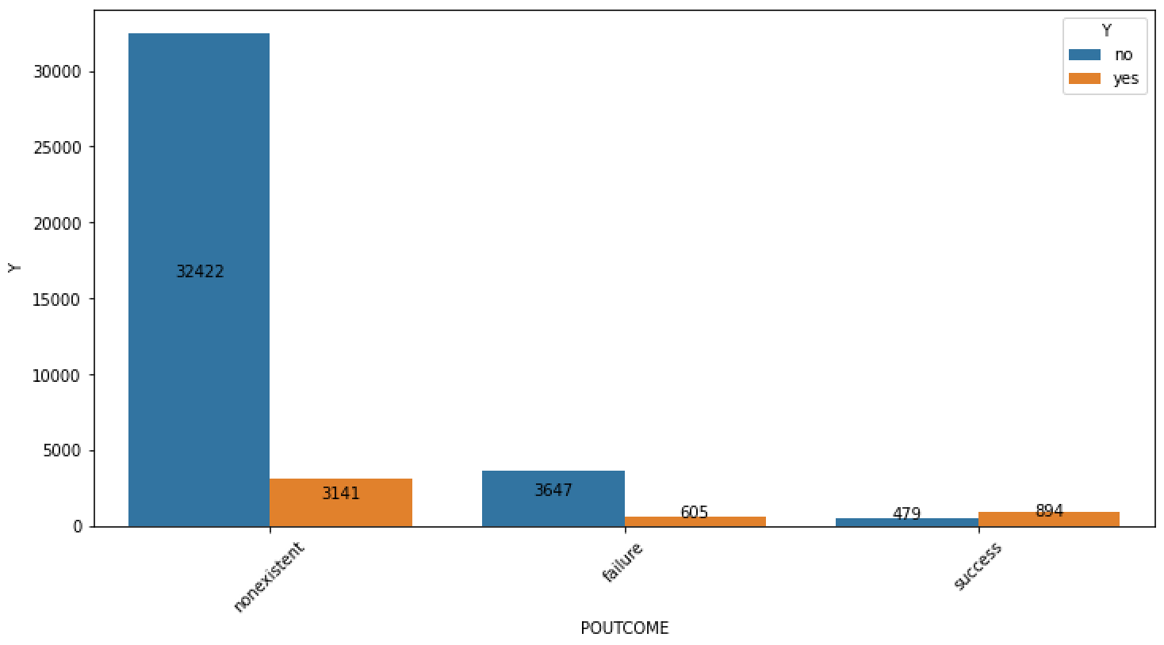
Data Visualization - cont
Fig 36: POutcome versus Y
According to the data presented in Fig 36, there are 3,141 non-existent customers but have a term deposit.

Slide 22
EDA Summary
Although there were no missing values, the “unknown” labels were present in the dataset. The correlation between EMP.VAR.RATE, EURIBOR3M, and NR.EMPLOYED, variables is more than 90 %. Understanding the fact that the categorical variables creates a relation with target variable at some level, it becomes crucial to also understand the time duration spent with the customer during the call might also impact the customers decision to subscribe for term deposit.

Slide 23
Recommendations
As analysed with the dataset, the occupation, education, contacted day and month are impacting the customers to opt for term deposit. Hence, the recommendation is to contact the customer keeping below observations into account.
Customers employed in administrative roles are more inclined to choose a term deposit option.
Customers with a university degree are more likely to opt for a term deposit. This indicates that students and retirees are more receptive to being contacted and converting the marketing campaign into a term deposit.
The month of May has had a greater impact on converting the marketing campaign into term deposits.
Monday and Thursday show slightly higher optimism when it comes to contacting customers during the marketing campaign.

Slide 24
Data Modelling
The binary classification problem of the Bank Marketing Campaign involves predicting whether customers will subscribe to the term deposit. The following machine learning models have been selected for this task:
Linear regression
Linear Discriminant Analysis
Random Forest Classifier
AdaBoost Classifier
XGBoost Classifier
Hist Gradient Boosting Classifier
The initial evaluation of all the aforementioned machine learning models resulted in the following accuracy scores for each model. The models will be further fine-tuned with their respective hyperparameters using techniques like cross-validation and grid search.
Model Name | Accuracy
LR | 90.402201
LDA | 90.191794
RFC | 91.073885
ADAB | 90.887756
XGB | 91.349033
HGBC | 90.677349

Slide 25
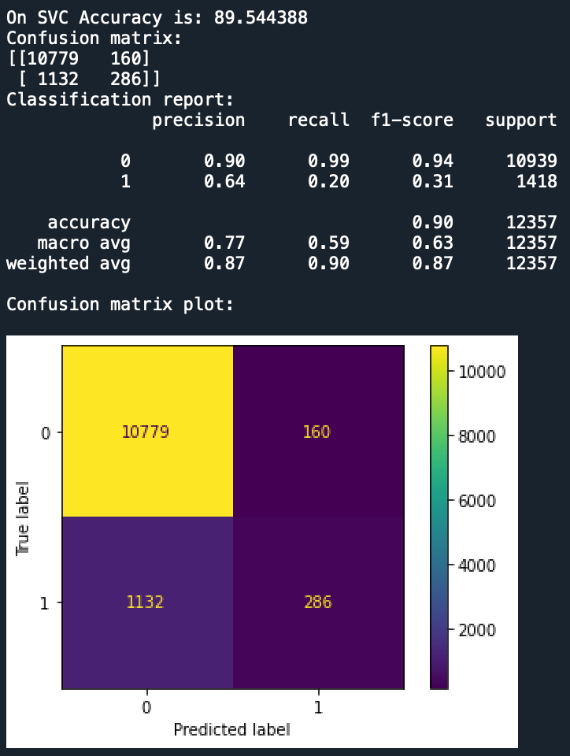
Data Modelling and Results
Feature Selection: Before implementing any model on the data, feature selection is necessary. Thus, the dataset is divided into two parts: features (all attributes except the target attribute) and target (class attribute). The target dataset includes only the ”Y” column, as it represents the class attribute. The remaining attributes are placed in the features dataset. Feature selection methods were not employed in this case due to the dataset’s limited number of attributes. Consequently, dimensionality reduction was not performed on this dataset.
Train and Test Split: The data is divided into training and test sets using the HoldOut method, with 70% of the data allocated to the training set and 30% to the test set. The training dataset contains 28,831 records and 20 attributes, while the test dataset comprises 12,357 records.
Baseline Model: The SVC model has been considered as the baseline model. The SVC model is trained using 70% of the data as the training set and then tested on the remaining 30% as the test set to assess accuracy. The evaluation results, depicted in Fig 37, show an accuracy of 89.54%.
Fig 37: Baseline SVC Model

Slide 26
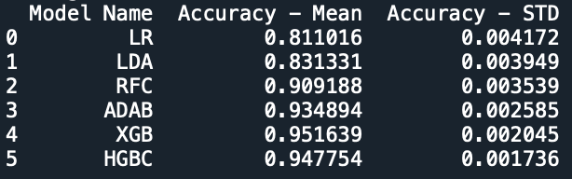
Data Modelling and Results
Linear Models: The basic Linear Regression model achieved an accuracy of 90.28% as depicted, while the Linear Discriminant Analysis model achieved an accuracy of 90.24% as shown. There is minimal difference in accuracy between these models without any hyperparameters. When considering the best random state, the Linear Regression model obtained an accuracy of 90.64%, and the Linear Discriminant Analysis model achieved 90.49%. Moving on to the model evaluation with cross-validation and random state, the Linear Regression model scored an accuracy of 80.84%, and the Linear Discriminant Analysis model achieved 83.13% accuracy.
For the tuned model evaluation as shown in Figure 38 and 39, which involved random state, cross-validation, and the best hyperparameters, the Linear Regression model achieved an accuracy of 81.10%, while the Linear Discriminant Analysis model maintained an accuracy of 83.13%. Comparing the results of the basic models, models with random state, cross- validation along with random state, and the tuned models, it can be observed that the models’ performance exhibited a slight decrease.
Ensemble Models: The basic Random Forest Classifier model achieved an accuracy of 91.01%, while the ADABoost model achieved an accuracy of 90.87%. There is minimal difference in accuracy between these models without any hyperparameters. When considering the best random state, the Random Forest Classifier model obtained an accuracy of 91.42%, and the ADABoost model achieved 91.16%.
Moving on to the model evaluation with cross-validation and random state, the Random Forest Classifier model scored an accuracy of 95.46%, and the ADABoost model achieved 92.68% accuracy.
For the tuned model evaluation as shown in Figure 38 and 39, which involved random state, cross-validation, and the best hyperparameters, the Random Forest Classifier model achieved an accuracy of 90.91%, while the ADABoost model maintained an accuracy of 93.48%. Comparing the results of the basic models, models with random state, cross-validation along with random state, and the tuned models, it can be observed that the performance of the Random Forest Classifier model has slightly decreased, whereas the performance of ADABoost has improved.
Fig 38: Tuned models accuracy

Slide 27
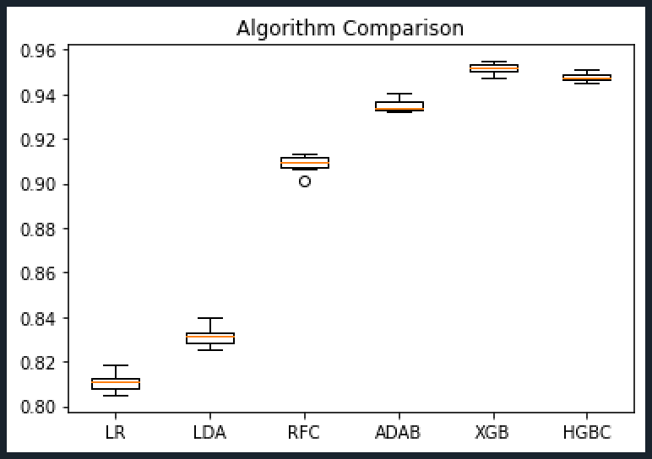
Data Modelling and Results
Boosting Models: The basic XGBoost model achieved an accuracy of 91.19%, while the HistGradientBoosting model achieved an accuracy of 91.50%. There is minimal difference in accuracy between these models without any hyperparameters. When considering the best random state, the XGBoost model obtained an accuracy of 91.42%, and the HistGradientBoosting model achieved 91.79%.
Moving on to the model evaluation with cross-validation and random state, the XGBoost model scored an accuracy of 95.09%, and the HistGradientBoosting model achieved 94.76% accuracy.
For the tuned model evaluation as shown in Figure 38 and 39, which involved random state, cross-validation, and the best hyperparameters, the XGBoost model achieved an accuracy of 95.16%, while the HistGradientBoosting model maintained an accuracy of 94.77%. Comparing the results of the basic models, models with random state, cross-validation along with random state, and the tuned models, it can be observed that the performance of the XGBoost model has shown a significant improvement, whereas the performance of the HistGradientBoosting model has slightly decreased.
Fig 39: Tuned models accuracy plot

Slide 28
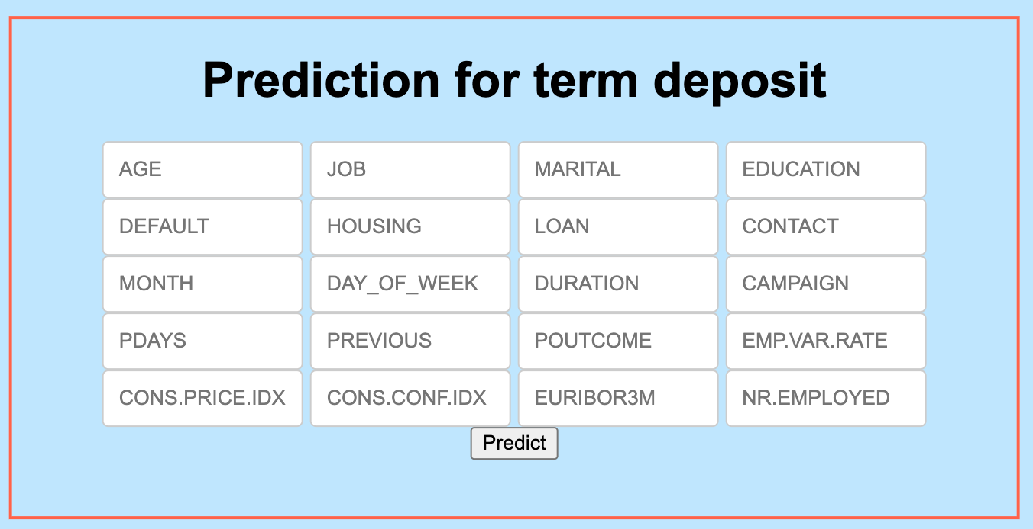
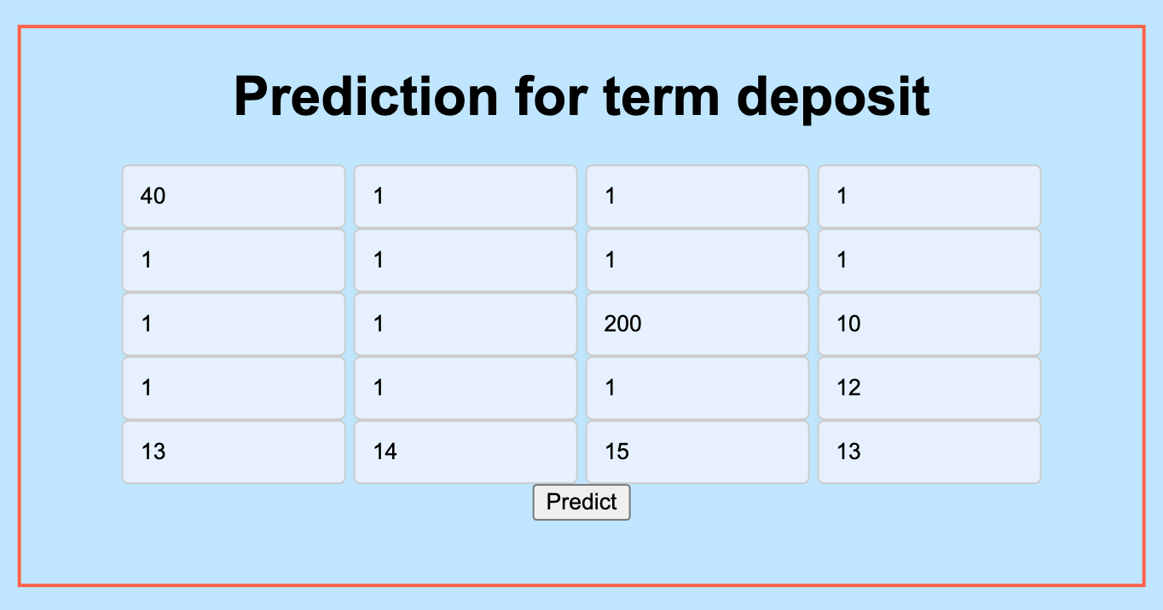
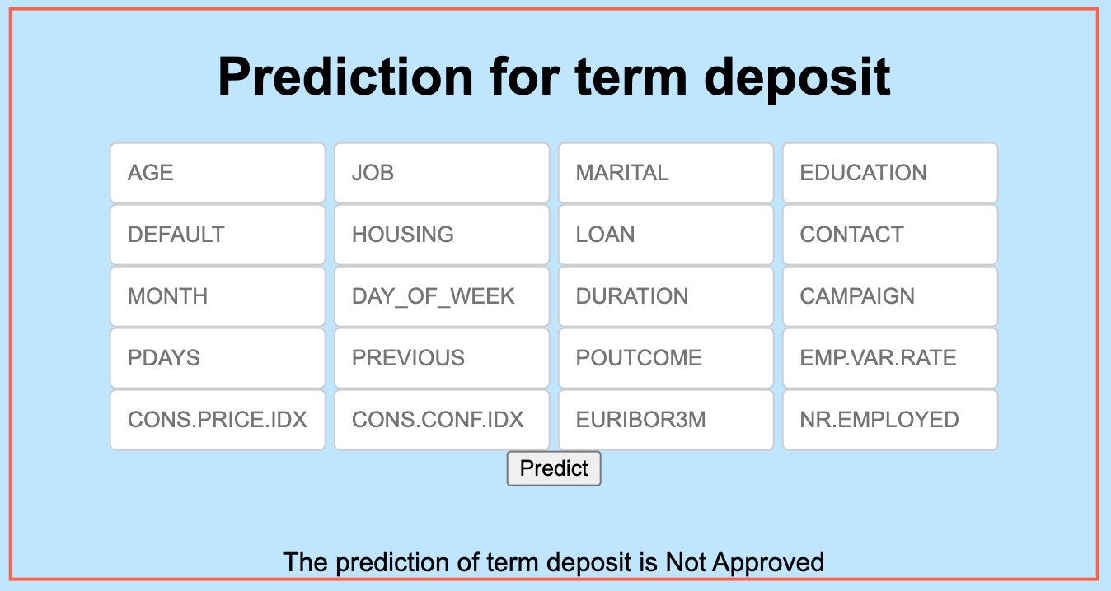
Model Deployment
Model deployment was achieved using Flask. The web page style and the page layout was defined. When executing the flask code for predict API, the URL ”http://127.0.0.1:5000/” is generated. The Fig 40 shows the web application produced. When entered the values in all the field to test the prediction as in Fig 41, the result produced in displayed below the ”predict” button as displayed in Fig 42.
Fig 40: Web page Fig 41: Input values in web page
Fig 42: Prediction of values entered

Slide 29
Discussion and Analysis
Analysis: The initial analysis involved exploring distribution of categorical and numerical variables. Data visualization was performed to gain insights into the relationships between different variables and the target variable, ’y’.
To build prediction, the models were trained and evaluated using various machine learning algorithms, including linear models (such as Linear Regressiona and Linear Discremininant Analysis), ensemble models (such as Random Forest Classifier and ADABoost), and boosting models (such as XGBoost and HistGradientBoosting). Performance metrics such as accuracy, precision, recall, F1-score, and ROC-AUC were used to evaluate model performance. Boosting model XGBoost consistently achieved high accuracy, above 90%, indicating their effectiveness in predicting customer subscriptions.
Significance of findings: Here are some key points highlighting the significance of the findings:
Class imbalance is a common challenge in marketing datasets, where non-respondents outnumber respondents. The analysis successfully addressed this issue by employing techniques like SMOTE and RandomUnderSampler. This ensures that the model does not favour the majority class and provides more balanced and reliable predictions.
Data-Driven Decision Making: The analysis promotes a data-driven approach to decision- making in the banking industry. Instead of relying solely on intuition or assumptions, banks can leverage the insights from the machine learning models to make informed decisions regarding their marketing campaigns, product offerings, and customer engagement strategies.
Limitation: The bank marketing campaign analysis has provided valuable insights, but it is essential to acknowledge its limitations to ensure a comprehensive understanding of the study. Limited dataset, imbalanced data, missing data comprises of ”unknown” values are some limitation encountered in this research. By acknowledging these limitations, future research can fo- cus on mitigating them and enhancing the analysis’s accuracy and applicability to real-world scenarios.

Slide 30
Conclusion and Future Work
Conclusions
This research paper explores various approaches to find the best machine learning solution for predicting term deposits based on bank marketing campaign data. The baseline model considered was the Support Vector Machine model, as referenced in the data [1]. Among the Linear models, we evaluated Linear Regression and Linear Discriminant Analysis. In the Ensemble models, we considered Random Forest Classifier and ADABoost models. For boosting models, we evaluated XGBoost and HistGradientBoosting models. The results discussed of all the models showed that the XGBoost model stood out as the best-performing model. Consequently, we utilized XGBoost to create the web application using Flask.
Future work
Despite the significant contributions made in handling the numerous categorical and numeric variables in the bank marketing campaign dataset, there are still a few limitations in this research paper. As discussed in previous slides, the paper primarily focuses on machine learning models. In the future, it would be worthwhile to explore other avenues, such as cross-platform and deep learning models, to further evaluate and predict future term deposits. These additional approaches could potentially enhance the accuracy and insights derived from the dataset.

Slide 31
References
[1] Aditi, D. [2023], ‘aditidadariya / bankmarketingcampaign’, https://github.com/ aditidadariya/BankMarketingCampaign. (accessed regularly).
[2] Moro, S., R. P. and Cortez, P. [2012], ‘Bank Marketing’, UCI Machine Learning Reposi- tory. DOI: https://doi.org/10.24432/C5K306.
[3] Pan, Y. and Tang, Z. [2014], Ensemble methods in bank direct marketing, in ‘2014 11th International Conference on Service Systems and Service Management (ICSSSM)’, pp. 1–5.
[4] Saeed, S. E., Hammad, M. and Alqaddoumi, A. [2022], Predicting customer’s subscription response to bank telemarketing campaign based on machine learning algorithms, in ‘2022 International Conference on Decision Aid Sciences and Applications (DASA)’, pp. 1474– 1478.
[5] Subramanian, M., Bhukya, S. N., Vijaya Prakash, R., Raju, K. N., Ray, S. and Pandian, M. [2023], Deploy machine learning model for effective bank telemarketing campaign, in ‘2023 International Conference on Distributed Computing and Electrical Circuits and Electronics (ICDCECE)’, pp. 1–6.

Slide 32
Thank You

